Slide 1
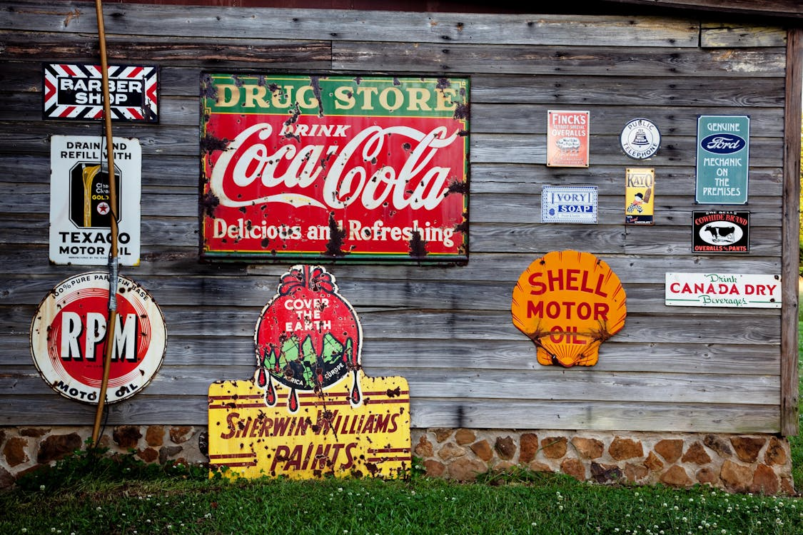

Cx Ad Perceptions
Phase I & II
RESEARCH REPORT | SEPT 2025|
KELLY PETERSON

Slide 2
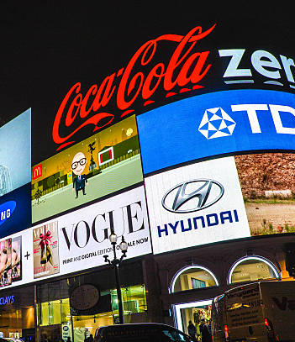
1
Background & Approach
2
How do Cx feel about advertisements in general?
3
How do Cx feel about advertisements on DoorDash?
4
Insights, Recommendations &
Next Steps

Slide 3
Background &
Approach

Slide 4
Background
As a design team, we should champion designs that elevate advertising. Our goal is to lead the industry in redefining how beautiful, human-centered advertising can drive both delight and performance. However, we don’t know how to define this for our Cx.
Research Objective
This research aims to shed light on Cx perceptions and preferences of ads today to build an ads experience of tomorrow that is engaging and builds vs. breaks Cx trust.
Full Research Brief Here
Qualitative Follow Ups
Methodology
Phase 1: 10-15 min survey with N=480 DoorDash CX.
Cx had visited the app in the past 14 days
Includes a mix of DashPass (n=) and Classic (n=)
The survey focused on understanding Cx opinions of ads on general as well as ads on DoorDash.
Phase 1: 3 Follow Up 30 min conversations
Included a mix of perspectives about ads and experiences with ads on DoorDash
Cx had consented to follow up conversations in the survey

Slide 5
How do Cx feel about advertisements in general?

Slide 6
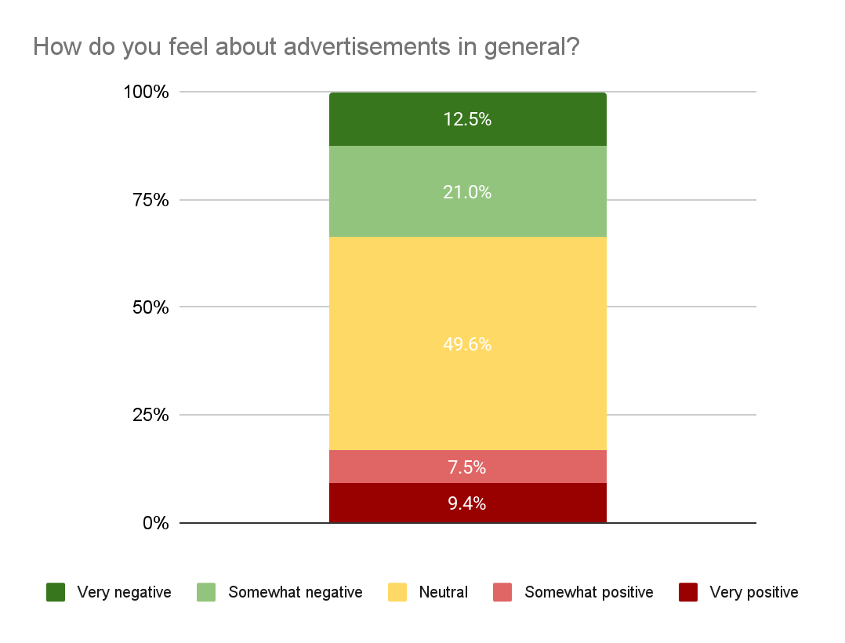
Cx are pretty reasonable when it comes to ads and overall feel neutral about them
How do you feel about advertisements in general?
Cx are used to seeing ads everywhere and expect them to be there.
Very positive
“
”
I mean it’s business
“
”
It’s a necessary evil
Very negative

Slide 7
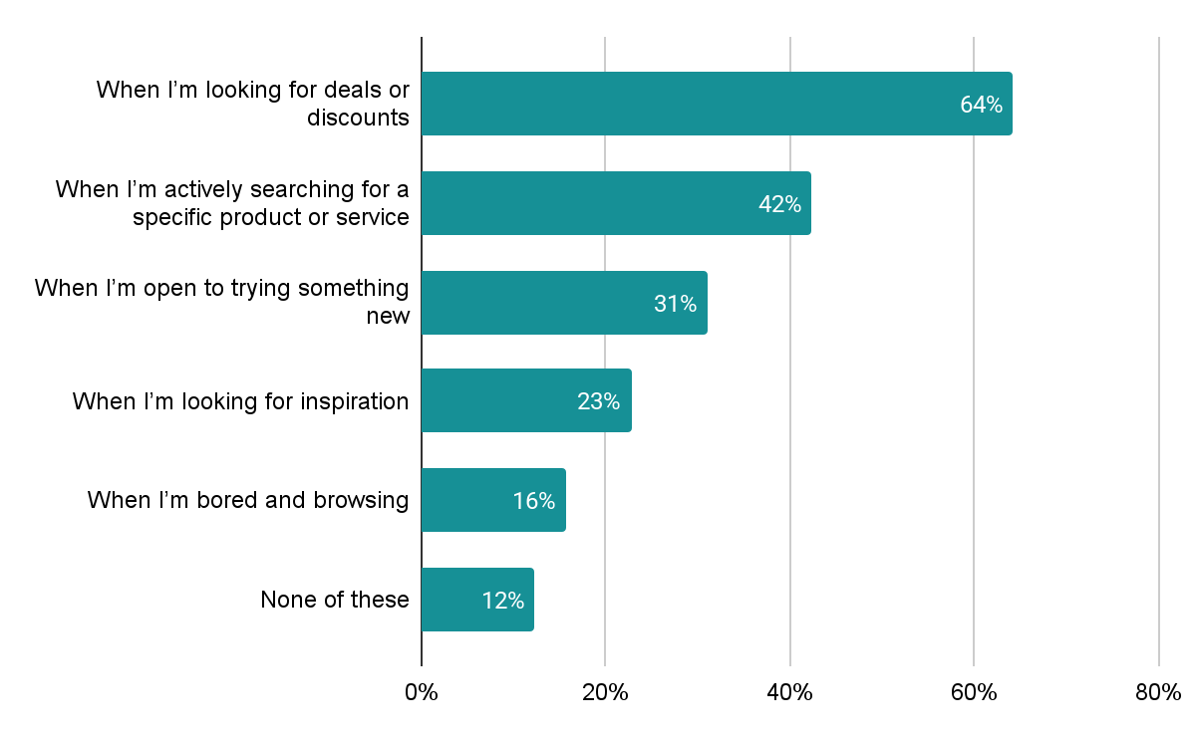



In which situations are you more likely to be open to ads?
Cx find the most value when ad placements are aligned to session intent
Which platforms have ads that you generally find helpful or meaningful?
1.
2.
3.

Slide 8
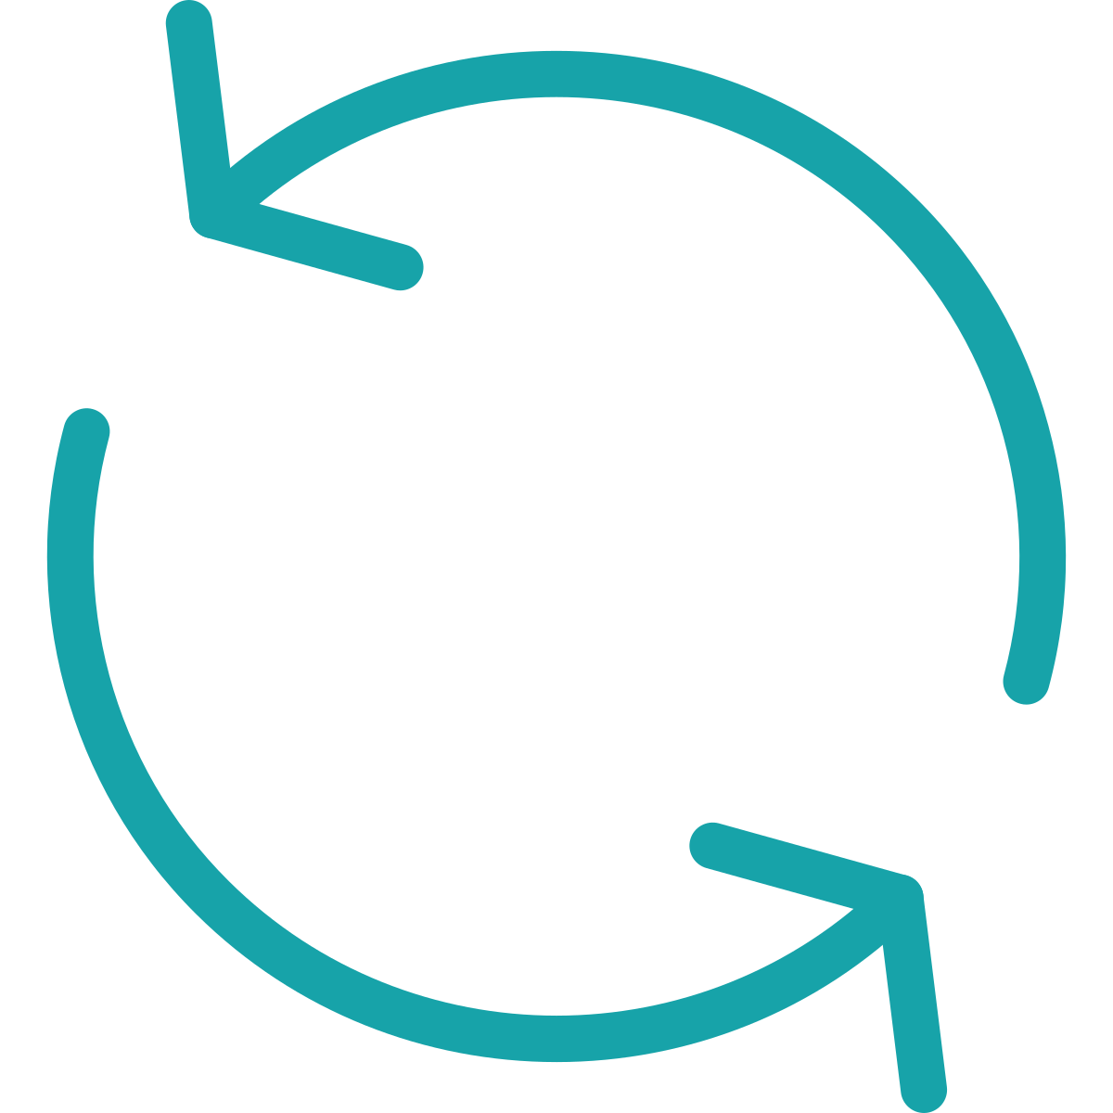
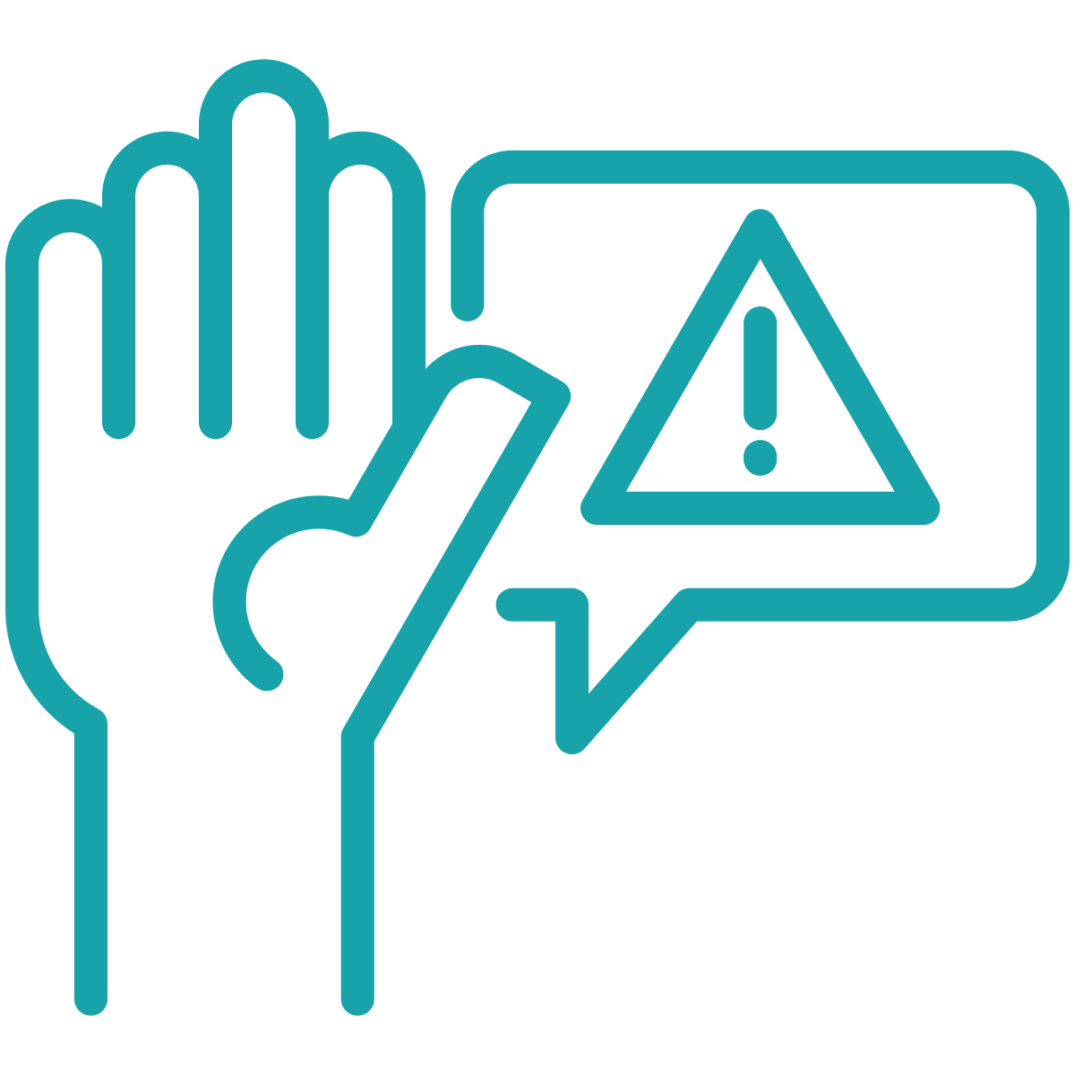
Ads create friction when they are repeated too often and block Cx from completing their task
What makes an ad feel intrusive or bothersome?
“
 | 1 | It repeats too often
 | 2 | It’s too long or hard to skip
 | 3 | It interrupts what I was doing
 | 4 | It feels manipulative or dishonest
 | 5 | It’s irrelevant to me
 | 6 | It comes from a brand I don’t trust
Repeating the same ad constantly. I just saw that ad, and then I just see it again. Two scrolls down, or if I'm on a webpage, I see it on the top, and then I see it again at the bottom. Same ad. Like an ad that's repetitive too much.
”

Slide 9
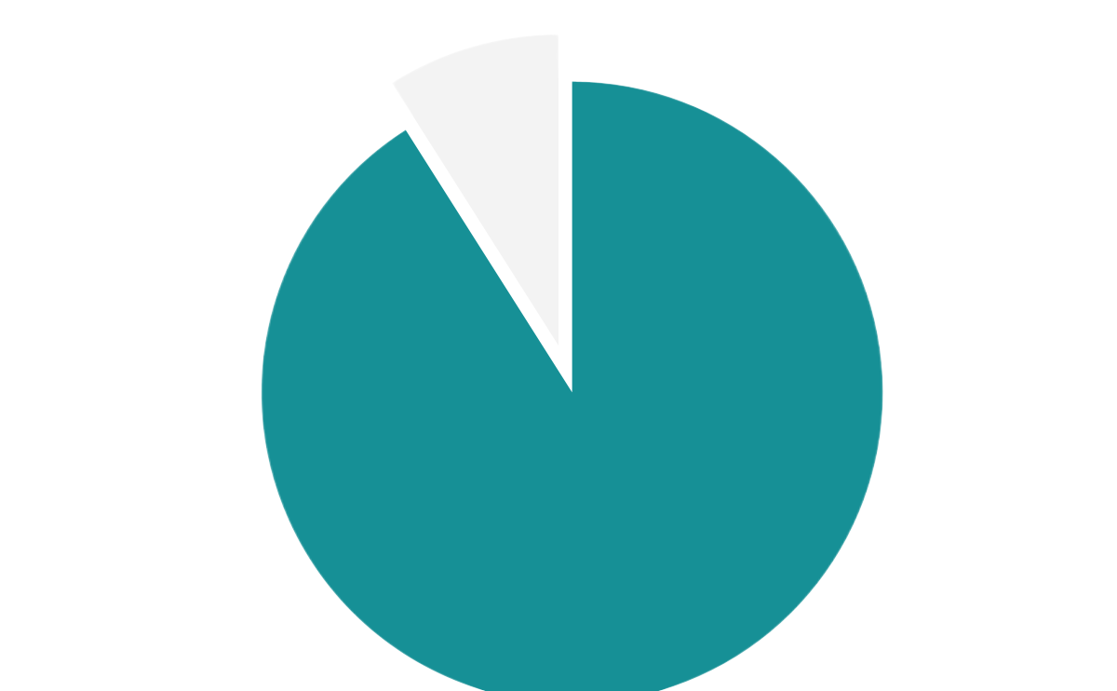

Almost all Cx have lost trust in a platform or brand due to an ad at some point
Cx typically lose trust in a brand/platform when an ad
Looks like fake content/click bait
Feels like it is tracking me too closely
Promoted a poorly rated product or place
Not relevant to me at all
Appears where I don’t expect to see it
91% of Cx have experienced an ad that “broke their trust”

Slide 10
A quick recap…
Cx have a neutral baseline expectation of ads. Customers are accustomed to ads across platforms and generally accept their presence as “standard”. Seeing ads doesn’t surprise them—it’s consistent with their experiences elsewhere
Ad value comes from relevance. Ads are tolerated—even welcomed—when they align with the customer’s intent at that moment (e.g. hungry → restaurant deal, shopping → product discount). This is why ads on Instagram, Amazon, or Google are often viewed positively: Cx feel they currently match the context of browsing, searching, or shopping
Ads can quickly cross the line into major points of friction. Intrusiveness is the main trigger for negative sentiment. This includes:
Repetition (seeing the same ad too often)
Disruption (ads that interrupt the task flow, like blocking checkout or autoplay videos)
Hard-to-skip or lengthy formats (full-screen, unskippable videos)
Ads that appear misleading (clickbait-style) or overly personal (feeling like they come from excessive data tracking) amplify frustration and distrust.

Slide 11
How do Cx feel about advertisements on DoorDash?

Slide 12

The majority of Cx have a hard time recalling ads on DoorDash, or are not sure if DoorDash has ads
One-third of Cx do not recall seeing advertisements on DoorDash

Slide 13

Those that do recall seeing deals or emails; however, some ad recalls are not actually advertisements at all.
What advertisements have you seen on DoorDash recently?
Deals, discounts or coupons
Emails & push notifications
Grocery or convenience store ads (for the vertical as well as for stores)
Sponsored restaurants and search placement
Home carousels (e.g. recommended for you)
Local/new restaurants
DoorDash services (e.g. DashPass)
Cart add ons (Doubledash & add to your cart)

Slide 14
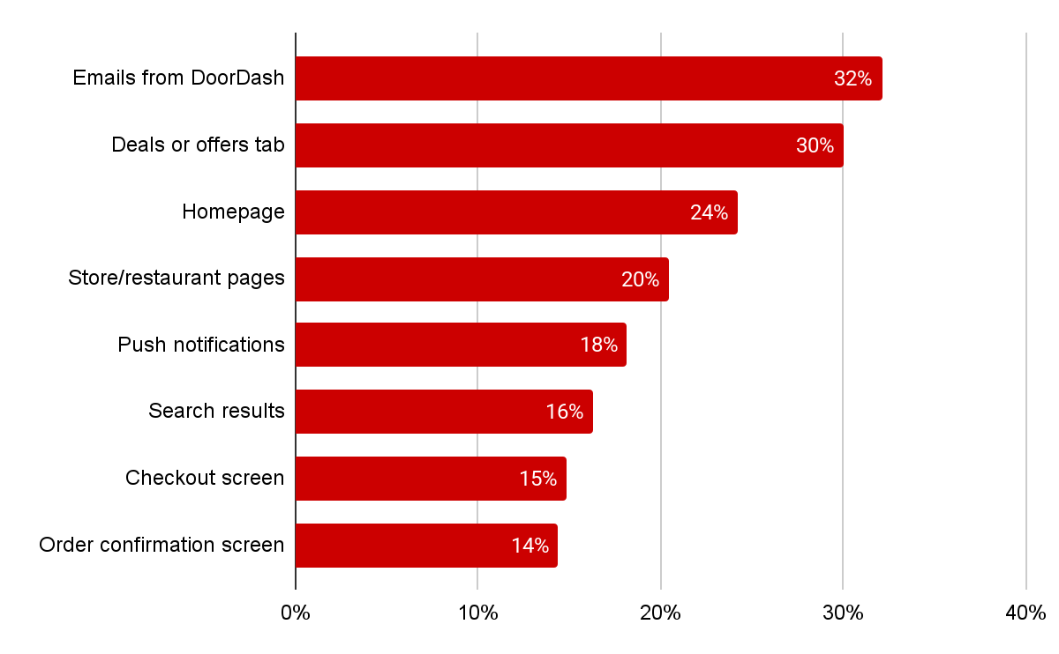
Outside of email, Cx recall seeing ads on the Deals tab and/or the homepage.
Few Cx indicate they have seen search ads/sponsored search.
Where have you seen advertisements while using DoorDash?

Slide 15
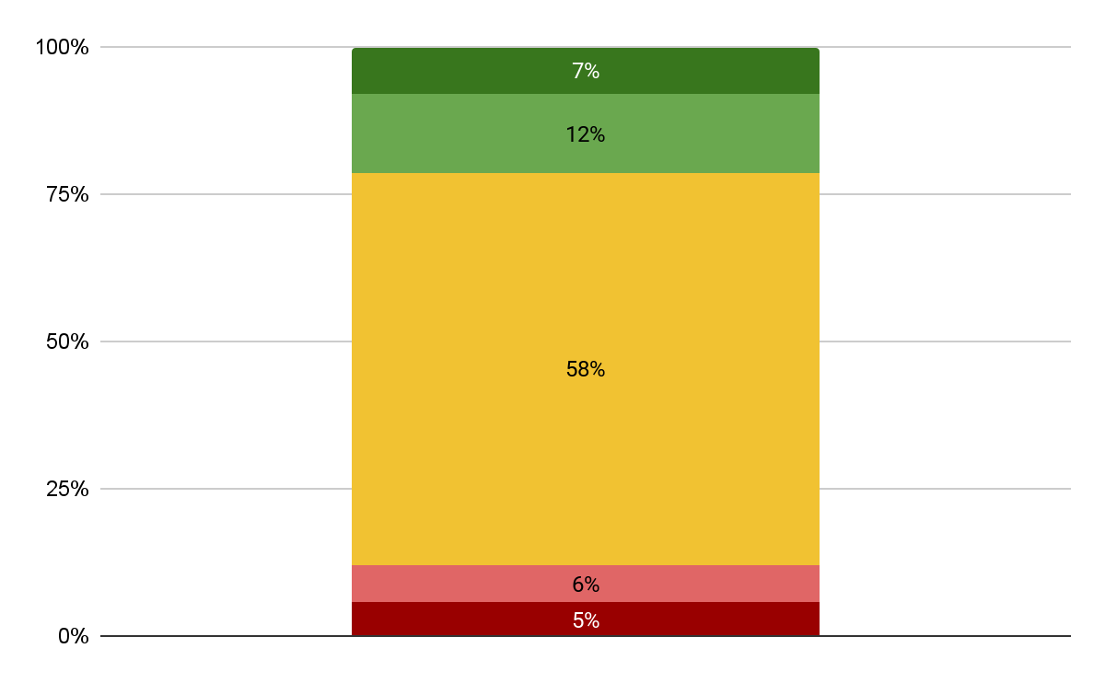


The majority of Cx feel neutral about ads on DoorDash today; they are mostly helpful to find deals
How do you feel about advertisements on DoorDash?
The most helpful/meaningful advertisements on DoorDash…
Highlight a great deal or promo
Feature a restaurant I’ve ordered from before
Introduces me to something new
Very positive
Very negative

Slide 16
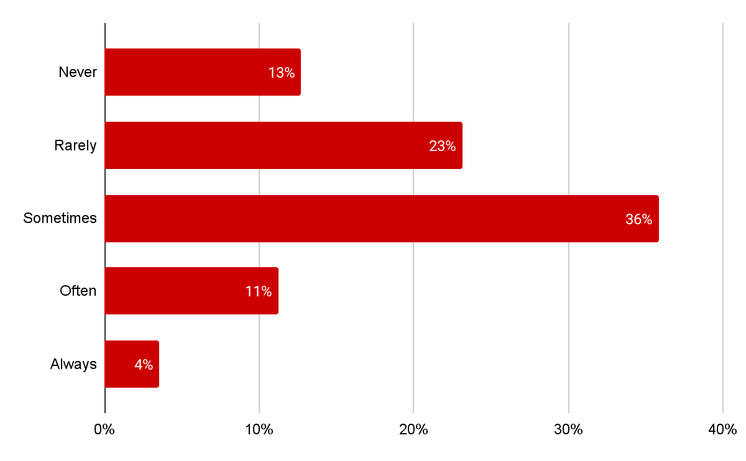
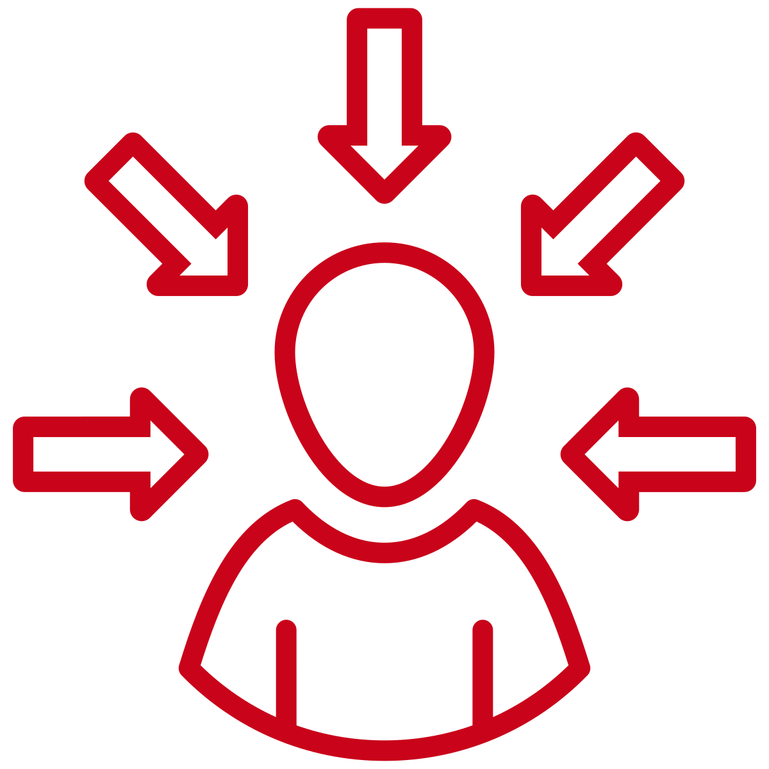
Cx feel comfortable with the current ad frequency on DoorDash
How frequently do you see advertisements on DoorDash?
The majority of Cx feel that they should only see a handful of visits each DoorDash session.
One-third of Cx prefer one ad per visit
One-quarter of Cx feel that a few ads a visit is ok

Slide 17
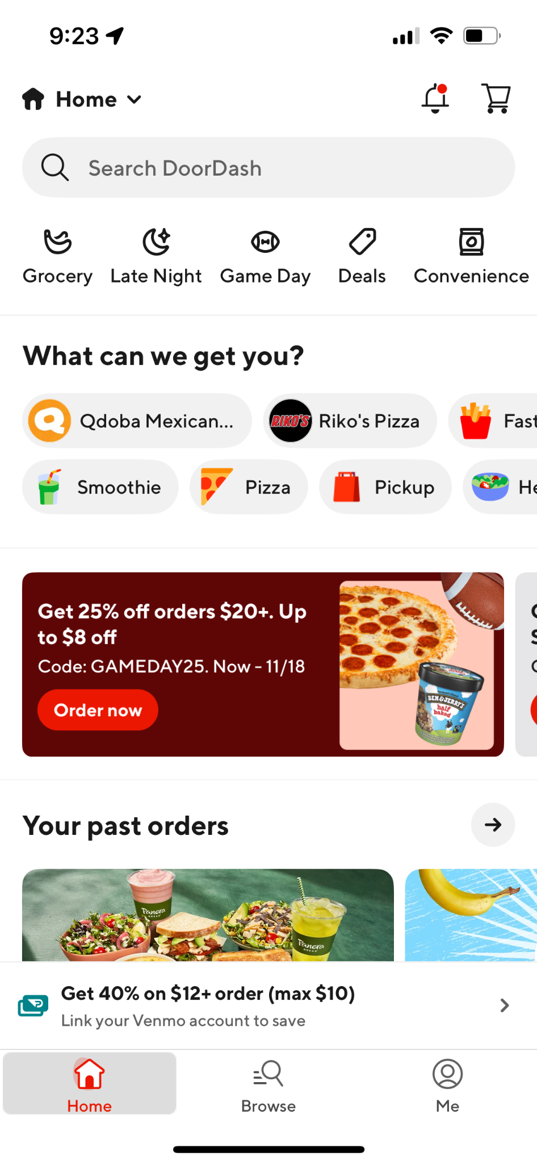
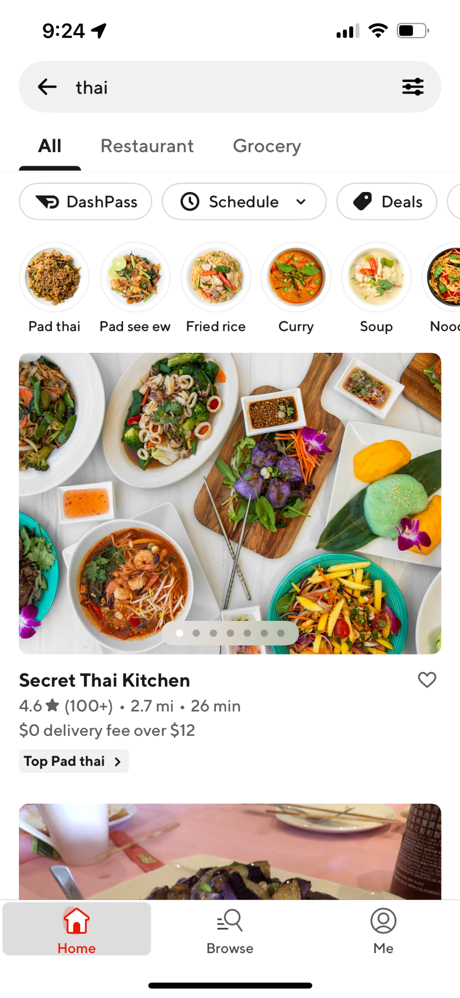
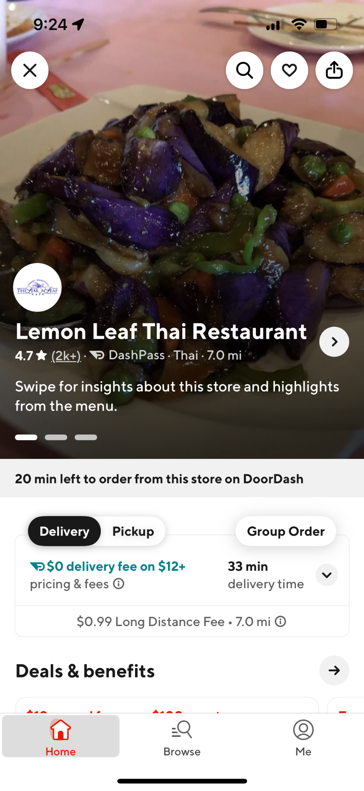
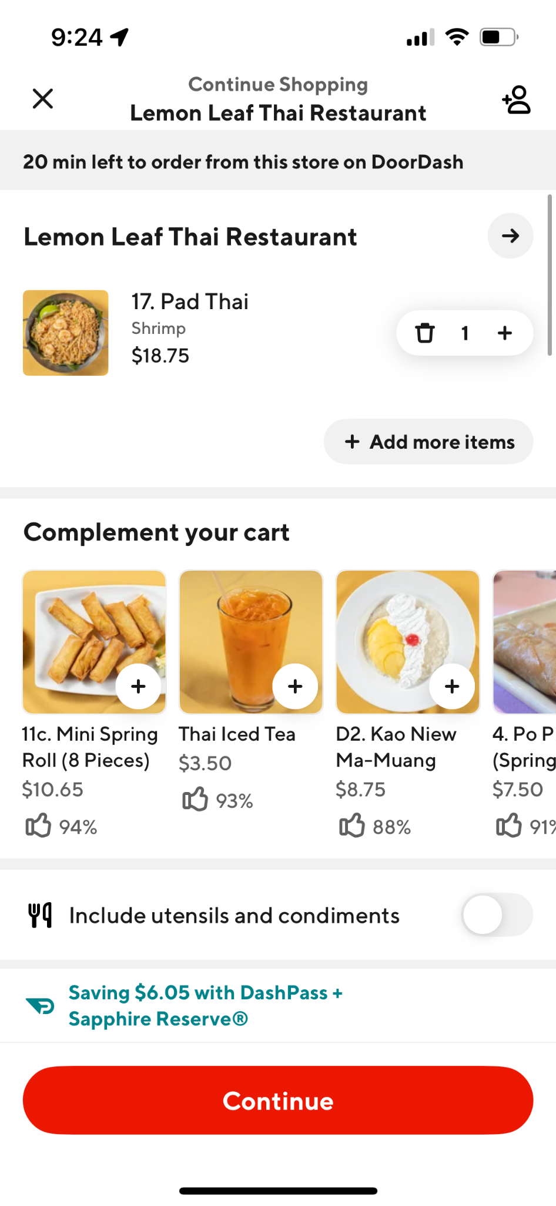
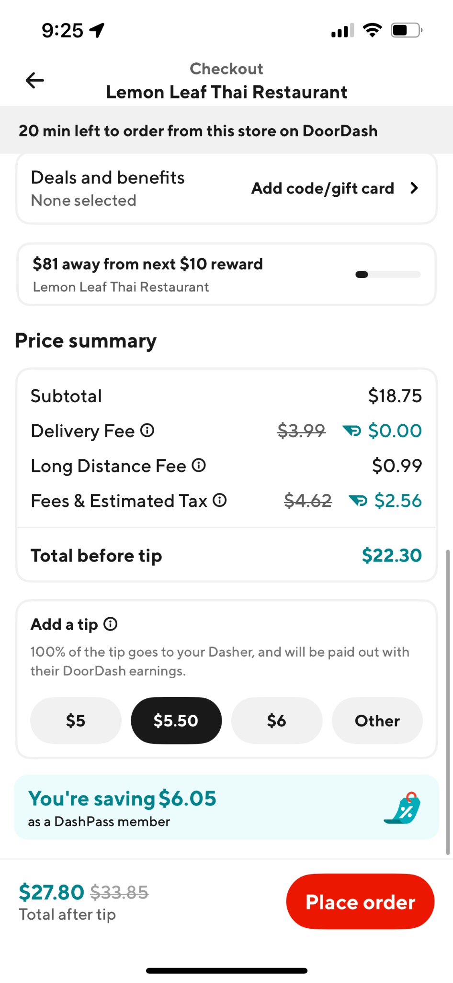
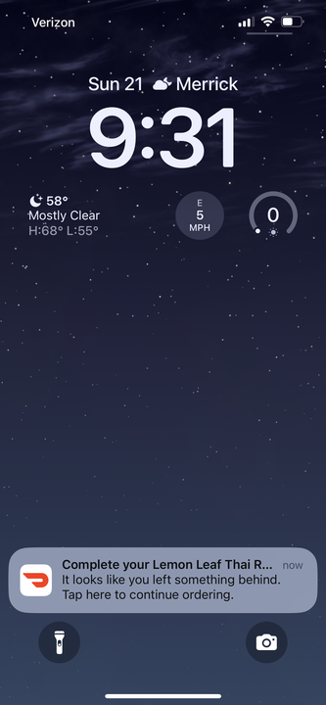
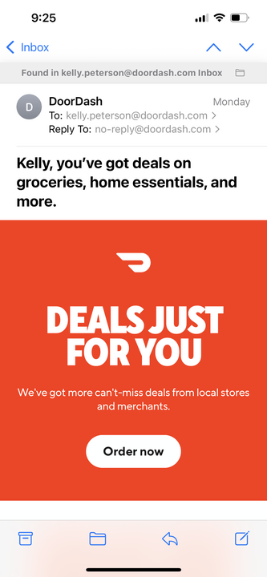

Cx expect to see ads top of funnel; later in the ordering process becomes too intrusive
Homepage | Search | Storepage | Checkout | Post-checkout | Push notifications | Email
✅ | ✅ | ✅ |  |  |  | Proceed with caution

Slide 18
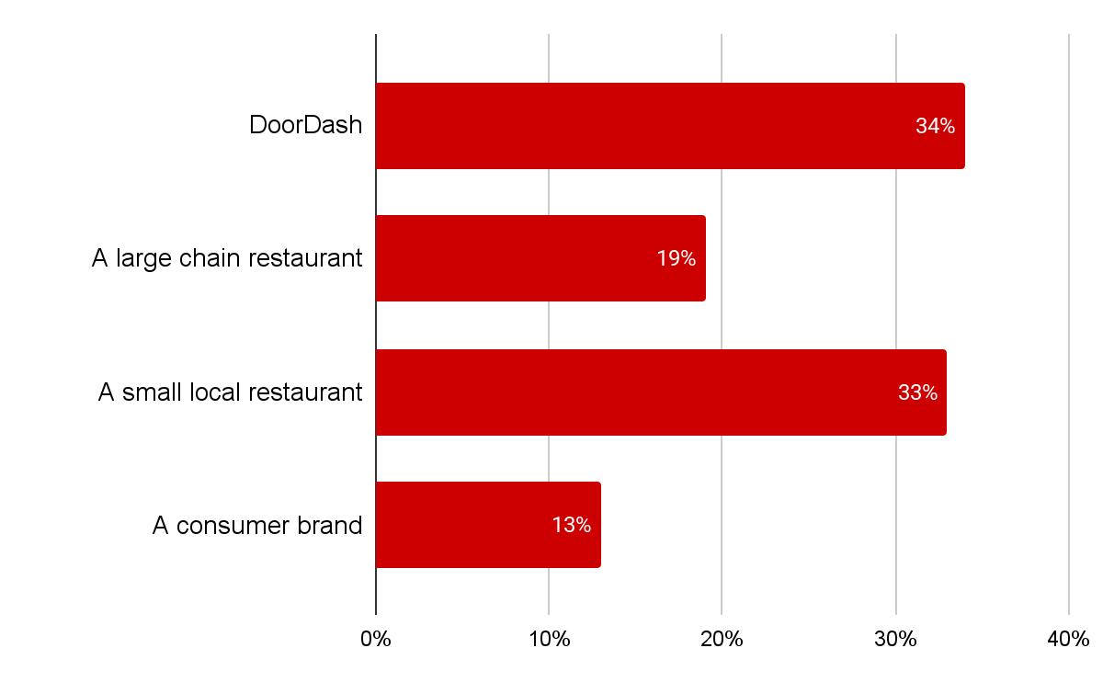
While Cx say they are not largely impacted by the source of an ad, SMBs garner greater trust than ENT or CPG when it comes to ads
Which of the following sources would you trust the most?
12%
of Cx indicated that the source of the ad impacts their perception of an ad “a lot” or “completely changes their opinion”

Slide 19
Summary of insights
Low salience of DoorDash ads: Many customers don’t even realize DoorDash runs ads—indicating they are currently subtle and not too intrusive.
Neutral baseline sentiment: When Cx are aware of ads on DoorDash, they are not seen as overly frequent and are usually accepted as part of the experience.
Where ads are seen: Cx recall homepage, deals tab, and emails as the most common placements of ads, though sometimes they recall ads that are not actually ads
What resonates: Ads that highlight good deals, promotions, or new restaurants are viewed as the most meaningful
Cx expect ads to remain top of funnel: Cx would prefer that ads are only super visible once to a small handful of times during a visit to DoorDash and are extremely limited in their journey beyond the store page. Cx currently feel a lot of checkout/post checkout experiences are ads (e.g. cart add-ons and Doubledash)
Small vs. big business impact: Source doesn’t strongly matter, but there’s more goodwill toward ads promoting small/local restaurants compared to large chains or CPG brands
Trust today, but fragile: DoorDash ads is trusted and accepted now, but repetitive ads or ads creeping into late funnel moments (e.g. checkout) could quickly undermine this trust

Slide 20
Recommendations & Next Steps

Slide 21
Recommendations
Keep Ads Contextual
Prioritize placements that match where customers are in their journey (homepage, deals tab, emails)
Lean into deals, discounts, and discovery of new/local restaurants, as these align to why customers are on the platform
Avoid Intrusiveness
Do not introduce long, non-skippable, or interruptive formats
Limit repetition of the same ad/restaurant to prevent banner blindness and frustration, an ad should be seen no more than one time per interaction and no more than 2-3 ads overall per interaction
Ads should not be stacked together in search results
Balance Category Expansion
Test NV and adjacent category ads carefully in the Rx space—ensure they feel relevant within the customer’s order history
Champion Local Businesses
Elevate small/local restaurant ads where possible, as customers perceive them more positively than large enterprise/CPG ads
Protect Trust at Checkout
Keep checkout focused on completion; if ads appear here, they should be subtle, additive, and skippable (e.g., simple dessert or add-on prompts)
Maintain the “Subtle Balance”
Continue with the current light-touch approach to ads on DoorDash. Customers don’t mind them now because they’re not overwhelming—scaling up volume or aggressiveness risks tipping sentiment negative

Slide 22
Recommended Design Principles
1. Intent-First. Ads should align with why the customer is on DoorDash (finding food, deals, discovery). Focus on promotions, new/local restaurants, and relevant NV tie-ins.
2. Helpful, Not Intrusive. Ads should feel like a service (helping save money, surface variety) rather than an interruption. Avoid formats that are long, unskippable, or block task completion.
3. Trust by Design. Keep ads transparent and clearly labeled (e.g., “Sponsored,” “Deal”). Avoid clickbait, fake-feeling content, or overuse of personal data (without explanation).
4. Light-Touch Frequency. Maintain a balance: ads should be visible but not overwhelming. Limit repetition of the same restaurant or offer to reduce fatigue.
5. Contextual Placement. Early journey: homepage, deals tab, search results, storepage → high visibility, low friction. Late journey: checkout → only lightweight that feel additive
6. Champion Local. Elevate ads for small/local businesses alongside chains to build goodwill and community trust.
7. Frictionless Flow. Ensure ads don’t disrupt the core task (ordering food quickly).

Slide 23
Next steps
Let’s brainstorm ways we can make ads more exciting, sticky and engaging!
We have 200+ Cx who consented to follow up conversations- we can use this for follow up questions or exploring ideas we come up with today
Have more questions? Let’s chat- I’m planning Q4 research now!

